Slide 1

UNSOLICITED E-MAIL SHOT
PRESENTED BY
Shubhi (2000290120160)
Shikhar Raj (2000290120144)
Abhijeet kannaujia (2000290120007)

Slide 2

INTRODUCTION
Spam e-mails can not be only annoying but also dangerous to consumers.
Spam e-mails can be defined as:
Anonymity
Mass Mailings
Unsolicited
Spam e-mails are the message randomly sent to multiple addressees by all sort of groups but mostly lazy advertiser and criminals who wish to lead you by phishing sites.

Slide 3
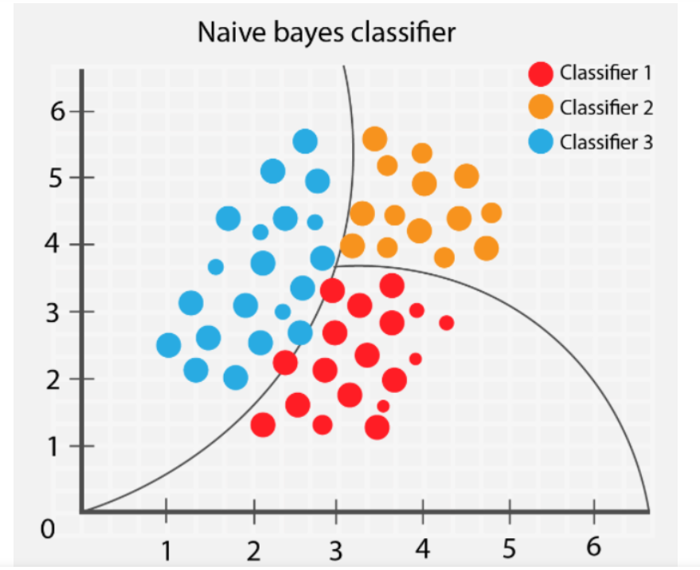
naïve BAYS CLASSIFIER
Naïve Bayes algorithm is a supervised learning algorithm, which is based on Bayes theorem and used for solving classification problems.
It is mainly used in text classification that includes a high-dimensional training dataset.
Naïve Bayes Classifier is one of the simple and most effective Classification algorithms which helps in building the fast machine learning models that can make quick predictions.
It is a probabilistic classifier, which means it predicts on the basis of the probability of an object.
Some popular examples of Naïve Bayes Algorithm are spam filtration, Sentimental analysis, and classifying articles.

Slide 4

problem statement
Unwanted e-mails irritating internet connection
Critical e-mail message are missed and/or delayed
Millions of compromised computers
Billions of dollars lost worldwide
Identity theft
Spam can crash mail servers and fill up hard drives

Slide 5

OBJECTIVE
The objective of identification of Spam e-mail are:
To give knowledge to the user about the fake e-mails and relevant e-mails.
To classify mail spam or not.

Slide 6
LITERATURE REVIEW
Applications of Machine Learning (ML) algorithms in cybersecurity provide significant performance enhancement over traditional rule-based algorithms. These intelligent cybersecurity solutions demand careful integration of the learning algorithms to develop a significant cyber incident detection system to formulate security analysts industrial level. The development of advanced malware programs poses a critical threat to cybersecurity systems. Hence, an efficient, robust, and scalable malware recognition module is essential for every cybersecurity product. Conventional Signature-based methods struggle in terms of robustness and effectiveness during malware detection, specifically in the case of zero-day and polymorphic viruses attacks. In this paper, we design an adaptive Machine Learning based active malware detection framework which provides a cybersecurity solution against phishing attacks. The proposed framework utilize ML algorithms in a multilayered feed-forwarding approach to successfully detect the malware by examining the static features of the web pages. The proposed framework successfully extracts the features from the web pages and performs a successful detection process for the phishing attack. In the multilayered feed-forwarding framework, the first layer utilizes Random Forest (RF), Support Vector Machine (SVN), and K-Nearest Neighbor (K-NN) classifiers to build a model for detecting malware from the real-time input. The output of the first layer passes to the Ensemble Voting (EV) algorithm, which accumulates earlier classifiers performance. At the third layer, adaptive frameworks investigate second layer input data and formulate the phishing detection model. We analyze the proposed frameworks performance on three different phishing datasets and validate the higher accuracy rate.

Slide 7
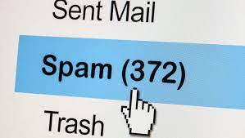
SCOPE OF THE PROJECT
It provides sensitivity to the client and adapts well to the future spam techniques.
It considers a complete message instead of single words with respect to its organization.
It increases security and control.
It reduces IT administration costs.
It also reduces Network Resource costs.

Slide 8
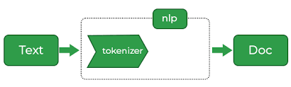
DOCUMENT PREPROCESSING
Tokenization
Tokenization, when applied to data security, is the process of substituting a sensitive data element with a non-sensitive equivalent, referred to as a token, that has no intrinsic or exploitable meaning or value. The token is a reference (i.e. identifier) that maps back to the sensitive data through a tokenization system. The mapping from original data to a token uses methods that render tokens infeasible to reverse in the absence of the tokenization system, for example using tokens created from random numbers.
The tokenization system provides data processing applications with the authority and interfaces to request tokens, or detokenize back to sensitive data.

Slide 9
LEMMAtization
Lemmatization in linguistics, is the process of grouping together the different inflected forms of a word so they can be analyzed as a single item.
In computational linguistics, lemmatization is the algorithm process of determining the lemma for a given word.

Slide 10
Removal of a stop word
Sometimes, the extremely common word which would appear to be of very little value in helping select documents matching user need are excluded from the vocabulary entirely.

Slide 11
Requirement analysis
Functional Requirement
To classify the e-mail which is done by first taking out the feature vector extraction which involve first taking out whether the word is a spam or not.
Non-Functional Requirement
Ensure high availability of e-mail data here datasets.
User should get the result as fast as possible.
It should be easy to use i.e., user is just required to type the words and click then the result is displayed or user is just required to enter a pair of reasonable sentence.

Slide 12
Testing
1.We will test the datasets and find out which e-mail is spam and which mail is not spam.
2.We calculate the feature vector to know whether it is spam or non-spam.
3. Using this feature vector Naïve Bays Algorithm works by comparing the trained data to test the data.

Slide 13

DATASET
Dataset is a collection of data or related information that is composed for separate elements.
A collection of dataset for e-mail spam contains spam and non-spam messages.

Slide 14
Conclusion
Text classification with naïve bays algorithm is equally good and comparable with other method of classification.
One of the best advantages of Bayesian spam filtering is that it can be trained on a per-user basis.
The spam that the user receives is often related to online user activities.
The legitimate e-mails a user receives will tend to be different.

Slide 15
THANK YOU

